Slide 1

CSD 3102 ARTIFICIAL INTELLIGENCE TECHNIQUES MODULE IV
PLANNING
Topic: Planning Problem - Simple Planning agent - Blocks world - Planning as a Statespace Search - Partial Order Planning

Slide 2
MODULE IV | PLANNING |  |  |  | 9
Planning Problem – Simple Planning agent –Blocks world - Goal Stack Planning-Means Ends Analysis- Planning as a Statespace Search - Partial Order Planning-Planning Graphs-Hierarchical Planning - Non- linear Planning -Conditional Planning-Reactive Planning - Knowledge based Planning-Using Temporal Logic – Execution Monitoring and Re-planning- Continuous Planning-Multi-agent Planning-Job shop Scheduling Problem.

Slide 3
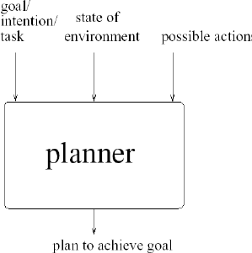
What is a Plan?
A sequence (list) of actions, with variables replaced by constants (specific objects in the environment)
Planner

Slide 4
PLANNING:
The task of coming up with a sequence of actions that will achieve a goal is called planning.
Classical planning:
We consider only environments that are fully observable, deterministic, finite, static (change happens only when the agent acts), and discrete (in time, action, objects, and effects). These are called classical planning environments.
Non-classical planning:
Non-classical planning is for partially observable or stochastic environments and involves a different set of algorithms and agent designs.

Slide 5
PLANNING PROBLEM:
1. Overwhelmed by irrelevant actions:
Consider the task of buying a copy of AI book: A Modern Approach from an online bookseller. Suppose there is one buying action for each 10-digit ISBN number, for a total of 10 billion actions.
The search algorithm would have to examine the outcome states of all 10 billion actions to find one that satisfies the goal, which is to own a copy of ISBN 0137903952. an explicit goal description such as, Have(ISBN0137903952) and generate the action Buy(ISBN0137903952).

Slide 6
In this scenario, we are dealing with a problem in goal-based agents
where the goal is to acquire a specific book identified by its ISBN,
say 0137903952 (referring to "Artificial Intelligence: A Modern Approach").
The task is framed as a search problem where we need to generate an action sequence
that achieves the goal of owning a copy of the book.
Here is a breakdown of the situation:
Possible Actions: There are 10 billion possible actions corresponding to
each unique 10-digit ISBN number. Each action represents
buying a book with a different ISBN.
So, buying ISBN0137903952 would be one of those actions.

Slide 7
Search Space: The search space here is the set
of all possible actions,which is a huge space containing
10 billion actions.
Goal Description: The goal can be explicitly defined
as having the book with the desired ISBN,
i.e., Have(ISBN0137903952).
The agent needs to find the action that will lead to this goal state.

Slide 8
Search Algorithm: If the agent uses a brute force search algorithm to find
the goal action, it might need to evaluate up to 10 billion actions.
In an efficient search strategy, we would look for actions that directly satisfy the goal,
which in this case is Buy(ISBN0137903952).
In this context, the agent's task is essentially to match the desired ISBN number
with the available options. Ideally, a well-optimized search algorithm wouldn't need to
go through all 10 billion options but instead would use heuristics or direct matching
(for instance, filtering for the correct ISBN) to significantly narrow down the search.

Slide 9
2. Finding a good heuristic function:
Suppose the agent's goal is to buy four different books online. Then there will be 1040 plans of just four steps, so searching without an accurate heuristic is difficult. It requires a human to supply a heuristic function for each new problem. For the book-buying problem, the goal would be Have(A) ∧ Have (B) ∧ Have(C) ∧ Have(D) , and a state containing Have (A) ∧ Have(C) would have cost 2. Thus, the agent automatically gets the right heuristic for this problem.

Slide 10
In this scenario, we are trying to explain how an agent can efficiently solve a problem like buying four books online using a heuristic function.
a.The Problem: The agent’s task is to buy four different books, A, B, C, and D. There are so many possible ways (around 10^{40}) to do this in just four steps (one step for each book). Searching through all these possibilities would take too long if the agent doesn’t have a good strategy.
b.Heuristic Function: A heuristic function helps the agent make better guesses about which action to take next. It is like giving the agent a sense of how far it is from achieving its goal. In most problems, a human has to design a special heuristic for the agent to use, which makes the search easier.

Slide 11
c. The Goal: The agent’s goal is to own all four books.
The goal state is written as: Have(A) ∧ Have(B) ∧ Have(C) ∧ Have(D). If the agent currently owns only two books, say A and C,
its current state is: Have(A) ∧ Have(C).
To reach the goal, it still needs books B and D.

Slide 12
d. Heuristic in This Problem: In this case, the heuristic is simple. The agent knows that each book requires one action (buying). If it already has two books (A and C), then it needs two more actions to get the remaining books (B and D). So, the agent automatically knows it’s 2 steps away from the goal.
Because the problem is structured in a way that lets the agent easily count the number of books it still needs, it automatically finds the right heuristic (the number of missing books). This makes the search for the correct plan much faster.
In short, the heuristic tells the agent how many books it still needs to buy, which helps it focus on getting the missing books quickly.

Slide 13
3. Problem decomposition:
The problem solver might be inefficient because it cannot take advantage of problem decomposition.
Consider the problem of delivering a set of overnight packages to their respective destinations, which are scattered across Australia.
Problem decomposition involves breaking down a large task into smaller, manageable sub-tasks. In the example of delivering packages across Australia, instead of solving the entire problem at once, we group packages by their nearest airport. Each group becomes a smaller subproblem, making it easier to find efficient delivery routes. This reduces complexity and allows for faster, more focused problem-solving.

Slide 14
THE LANGUAGE OF PLANNING PROBLEMS:
The representation of planning problems-states, actions, and goals-should make it possible for planning algorithms to take advantage of the logical structure of the problem.
The basic representation language of classical planners, known as the STRIPS(Stanford Research Institute Problem Solver) language.
STRIPS is insufficiently expressive for some real domains where Action Description Language (ADL) can be used.
Planning consists of following components:
Representation of states. Planners decompose the world into logical conditions and represent a state as a conjunction of positive literals. We will consider propositional literals;
Representation of goals. A goal is a partially specified state, represented as a conjunction of positive ground literals.
Representation of actions. An action is specified in terms of the preconditions that must hold before it can be executed and the effects that ensue when it is executed.

Slide 15
THE LANGUAGE OF PLANNING PROBLEMS:
In general, an action schema consists of three parts: describing how actions work in an AI planning system:
The action name and parameter
The precondition
The effect

Slide 16
The action name and parameter list-for example, Fly(p, from, to)-serves to identify the action.
The precondition is a conjunction of function-free positive literals stating which must be true in a state before the action can be executed. Any variables in the precondition must also appear in the action's parameter list.
The effect is a conjunction of function-free literals describing how the state changes when the action is executed. A positive literal P in the effect is asserted to be true in the state resulting from the action, whereas a negative literal ⌐P is asserted to be false. Variables in the effect must also appear in the action's parameter list.

Slide 17
Action Name and Parameters: The action is defined
with a name and a list of parameters.
For example, the action Fly(p, from, to)
represents flying a person p from one location (from) to
another (to).
These parameters identify the specific details of the action.

Slide 18
Precondition: The precondition is a set of conditions that must be true
before the action can happen.
For instance, before Fly(p, from, to) can be executed,
the precondition might be that the person p is already at the from location.
All variables (like p, from, to) that are used in the precondition must be
listed in the action's parameters.

Slide 19
Effect:
The effect describes what changes in the state after the action happens.
For example, after Fly(p, from, to) is executed,
the effect might be that the person is now at the to location.
A positive literal (like At (p, to)) becomes true in the new state,
and a negative literal (like ¬ At(p, from)) becomes false.
All variables used in the effect must also be listed in the action's parameters.

Slide 20
In summary, actions are defined with a name and parameters, preconditions state what must be true for the action to happen, and effects describe how the world changes after the action is performed.

Slide 21
STRIPS Examples: Example: Air cargo transport

Slide 22
In this air cargo transport problem, you're dealing with moving cargo between airports using planes.
The problem can be modeled with three basic actions: Load, Unload, and Fly. Each of these actions affects the state of two conditions (predicates):
Predicates:
1. In(c, p): This means cargo c is inside plane p. It tells us whether the cargo is currently loaded on a plane.
2. At(x, a): This means object x (which can be either a plane or a piece of cargo) is located at airport a

Slide 23
Actions:
Load(c, p, a):
Action: Load cargo c into plane p at airport a.
Precondition: The cargo c and plane p both must be at airport a (At(c,a) and At(p,a))
Effect: After the action, cargo c will be inside plane p (In(c,p)) and the cargo will no longer be at airport a (~At(c,a))

Slide 24
2. Fly(p, from, to):
Action: Fly plane p from one airport from to another airport to.
Precondition: The plane p must be at the airport from (At(p, from))
Effect: After the action, the plane p will be at the new airport to (At(p,to)) and it will no longer be at the airport from(~At(p,from))

Slide 25
3. Unload(c, p, a):
Action: Unload cargo c from plane p at airport a.
Precondition: The plane p must be at airport a (At(p,a)), and the cargo c must be inside the plane (In(c,p)).
Effect: After the action, cargo c will be at airport a (At(c,a)) and no longer inside the plane (~In(c,p))

Slide 26
STRIPS Problem:
In a STRIPS (Stanford Research Institute Problem Solver) problem like this, the task involves:
Initial State: Describing the starting situation (e.g., the cargo and planes at specific airports).
Goal State: Describing where you want the cargo to end up (e.g., which airport each piece of cargo should be delivered to).
Actions: Using the Load, Unload, and Fly actions to change the state from the initial state to the goal state.

Slide 27
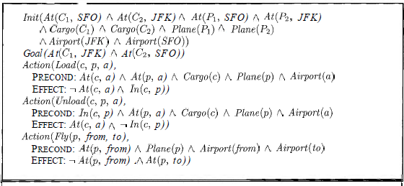
An air cargo transport problem involving loading and unloading cargo onto and off of planes and flying it from place to place. The problem can be defined with three actions: Load, Unload, and Fly.
The actions affect two predicates: In(c, p) means that cargo c is inside plane p, and A t ( x , a) means that object x (either plane or cargo) is at airport a.
A STRIPS problem involving transportation of air cargo between airports..

Slide 28
The following plan is a solution to the Air Cargo Transport problem:

Slide 29
Load cargo c1 in plane p1 from SFO airport then fly plane p1 from SFO to JKF and unload cargo c1 from plane p1 in JKF airport.
Load cargo c2 in plane p2 from JKF airport then fly plane p2 from JKF to SFO and unload cargo c2 from plane p2 in SFO airport

Slide 30
Example: The spare tire problem
Consider the problem of changing a flat tire. More precisely, the goal is to have a good spare tire properly mounted onto the car's axle, where the initial state has a flat tire on the axle and a good spare tire in the trunk. There are just four actions:
Removing the spare from the trunk
Removing the flat tire from the axle
Putting the spare on the axle
Leaving the car unattended overnight.
We assume that the car is in a particularly bad neighborhood, so that the: effect of leaving it overnight is that the tires disappear.

Slide 31
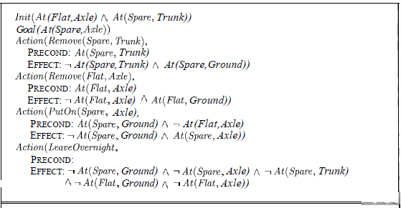
Example: The spare tire problem

Slide 32
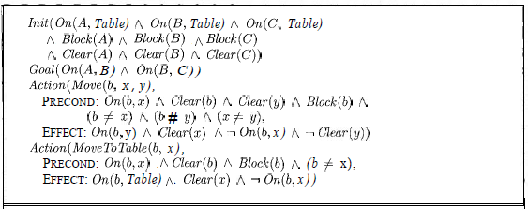
Building Block world problem

Slide 33
COMPONENTS OF A PLANNING SYSTEM:
Choose the best rule to apply the next rule based on the best available guess.
Apply the chosen rule to calculate the new problem condition.
Find out when a solution has been found.
Detect dead ends so they can be discarded and direct system effort in more useful directions.
Find out when a near-perfect solution is found.

Slide 34
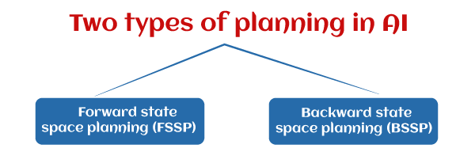
PLANNING WITH STATE SPACE SEARCH: Planning Algorithm
The most straightforward approach is to use state-space search.
Because the descriptions of actions in a planning problem specify both preconditions and effects, it is possible to search in either direction: either forward from the initial state or backward from the goal.
we have Forward State Space Planning (FSSP) and Backward State Space Planning (BSSP) at the basic level.

Slide 35
Forward State Space Planning (FSSP)
Forward State Space Planning (FSSP) is a method used in artificial intelligence for solving problems by searching through a series of states that can be reached through a sequence of actions. Here’s an explanation of how FSSP works:
Steps:
1.Initial State (S):
The planning process starts with an initial state S. This state represents the starting configuration of the problem.

Slide 36
2. Actions: At each step, you can perform actions that lead to new states. These actions are defined based on the problem domain and must satisfy certain preconditions to be executed. Each action transforms the current state S into a new state S′
3. Progression: The new state S′resulting from the action is referred to as a progression. This new state may introduce new terms (like newly achieved goals or conditions that are now true) based on the effects of the action.

Slide 37
4. State Space: The collection of all possible states and the actions that can lead from one state to another forms a state space. FSSP explores this space by continuously applying actions to reach new states.
5. Goal State: The process continues, applying necessary actions to progress through the state space until the agent reaches a goal state. The goal state represents the desired configuration or outcome of the problem.

Slide 38
Forward State Space Planning (FSSP) example using the air cargo transport problem:
Problem Overview
Goal: Move cargo from one airport to another.
Initial Setup:
Cargo:
Cargo C1 is at Airport A1
Cargo C2 is at Airport A2
Planes:
Plane P1 is at Airport A1
Plane P2 is at Airport A2

Slide 39
Initial State:
C1 is at A1
C2 is at A2
P1 is at A1
P2 is at A2
Goal State:
C1 should be at A3
C2 should be at A4

Slide 40
Actions
Load(cargo, plane, airport): Load cargo onto a plane at an airport.
Fly(plane, from, to): Fly a plane from one airport to another.
Unload(cargo, plane, airport): Unload cargo from a plane at an airport.

Slide 41
Steps to Reach the Goal
1. Load C1 onto P1 at A1:
Action: Load(C1, P1, A1)
New State:
C1 is in P1
C2 is at A2
P1 is at A1
P2 is at A2

Slide 42
2. Fly P1 from A1 to A3:
Action: Fly(P1, A1, A3)
New State:
C1 is in P1
C2 is at A2
P1 is at A3
P2 is at A2

Slide 43
3. Unload C1 from P1 at A3:
Action: Unload(C1, P1, A3)
New State:
C1 is at A3
C2 is at A2
P1 is at A3
P2 is at A2

Slide 44
4. Load C2 onto P2 at A2:
Action: Load(C2, P2, A2)
New State:
C1 is at A3
C2 is in P2
P1 is at A3
P2 is at A2

Slide 45
5. Fly P2 from A2 to A4:
Action: Fly(P2, A2, A4)
New State:
C1 is at A3
C2 is in P2
P1 is at A3
P2 is at A4

Slide 46
6. Unload C2 from P2 at A4:
Action: Unload(C2, P2, A4)
New State:
C1 is at A3
C2 is at A4
P1 is at A3
P2 is at A4

Slide 47
Result
Final State
Cargo C1 is At A3 (goal achieved)
Cargo C2 is At A4 (goal achieved)
In this simplified example, we started with cargo at two airports and successfully moved both cargos to their respective destinations using a series of loading, flying, and unloading actions. Each action brought us closer to the goal state.

Slide 48
Backward State Space Planning (BSSP)
Backward State Space Planning (BSSP) is a method in artificial intelligence for solving planning problems by working backward from a goal state to the initial state. This approach contrasts with Forward State Space Planning (FSSP), which progresses from the initial state toward the goal. Here’s a breakdown of how BSSP works:
1.Goal State:
The planning process begins with a goal state that describes the desired outcome of the problem.

Slide 49
2. Actions: Each action has a set of preconditions that must be satisfied for the action to be executed and an effect that describes how the state changes when the action is applied.
3. Working Backwards:
Starting from the goal state, BSSP identifies the actions that can lead to this state. For each action, it checks the preconditions that must be met to achieve that action.
The process continues by recursively working backwards through the states until reaching the initial state.

Slide 50
4. State Space: The collection of all possible states and the actions leading from one state to another forms the state space. BSSP explores this space in reverse.

Slide 51
Example of BSSP
Let’s illustrate BSSP with a simple example involving an air cargo transport problem, similar to the FSSP example but approached backward.
Goal State:
Cargo C1 is at Aiport A3
Cargo C2 is at Aiport A4

Slide 52
Actions:
Unload(cargo, plane, airport): Unload cargo from a plane at an airport.
Fly(plane, from, to): Fly a plane from one airport to another.
Load(cargo, plane, airport): Load cargo onto a plane at an airport.

Slide 53
BSSP Steps
1. Identify Goal State:
Cargo C1 at A3 and cargo C2 at A4.
2. Find Actions Leading to the Goal:
For Cargo C1:
Action: Unload(C1, P1, A3)
For Cargo C2:
Action: Unload(C2, P2, A4)

Slide 54
3. Check Preconditions:
For Unload(C1, P1, A3):
Preconditions: In(C1,P1) (Cargo C1 must be in plane P1 and At(P1,A3) (Plane P1 must be at A3)
For Unload(C2, P2, A4):
Preconditions: In(C2,P2) (Cargo C2 must be in plane P2 and At(P2,A4) (Plane P2 must be at A4)

Slide 55
4. Find Previous States:
For Action: Fly(P1, A1, A3) (to satisfy At(P1,A3)):
Preconditions: At(P1,A1) (Plane P1 must be at A1)
For Action: Fly(P2, A2, A4) (to satisfy At(P2,A4)):
Preconditions: At(P2,A2) (Plane P2 must be at A2)
5. Continue Backward:
Repeat this process until reaching the initial state.

Slide 56
BSSP is useful for complex planning problems where directly reaching the goal state might be difficult.
It allows for a structured way to identify the necessary actions and conditions needed to transition from the goal state back to the initial state.

Slide 57
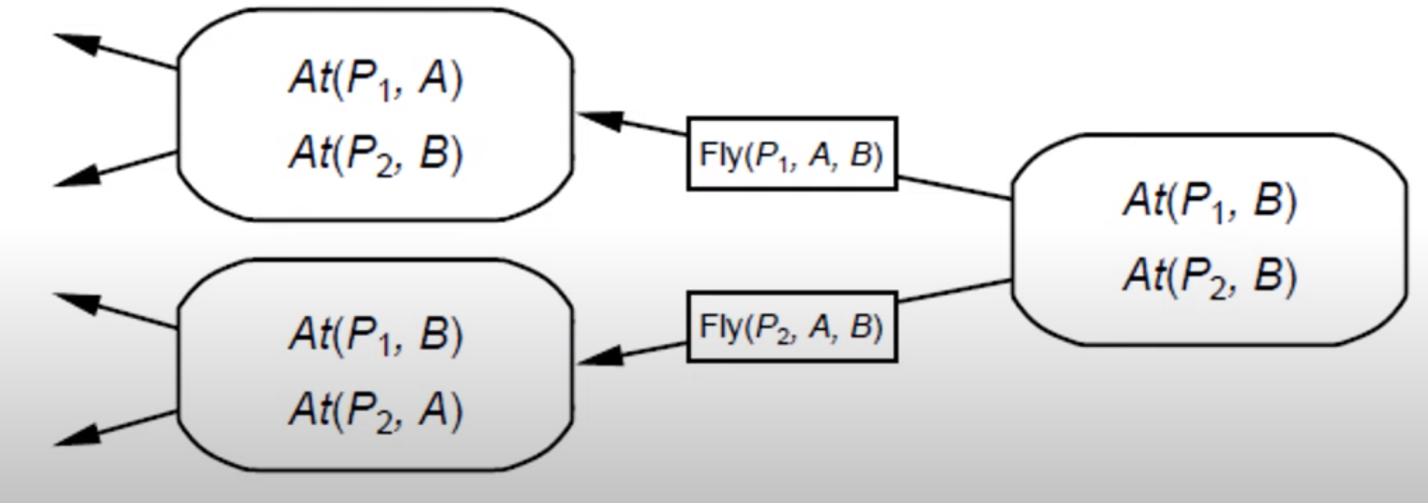
Backward State Space Planning (BSSP)
BSSP behaves similarly to backward state-space search. In this, we move from the target state g to the sub-goal g, tracing the previous action to achieve that goal.
This process is called regression (going back to the previous goal or sub-goal). These sub-goals should also be checked for consistency. The action should be relevant in this case.

Slide 58
Partial Order Planning

Slide 59
The Planning Problem
Formally a planning algorithm has three inputs:
A description of the world in some formal language,
A description of the agent’s goal in some formal language, and
A description of the possible actions that can be performed.
The planner’s o/p is a sequence of actions which when executed in any world satisfying the initial state description will achieve the goal.

Slide 60
Representation for states and goals
In the STRIPS language, states are represented by conjunctions of function-free ground literals, that is, predicates applied to constant symbols, possibly negated. For example,
At(Home)^ ¬ Have(Milk)^ ¬ Have(Bananas)^ ¬ Have(Drill)^….
Goals are also described by conjunctions of literals. For example,
At(Home)^Have(Milk)^ Have(Bananas)^ Have(Drill)
Goals can also contain variables. For example, the goal of being at a store that sells milk would be represented as

Slide 61
Representations for actions
Our STRIPS operators consist of three components:
the action description is what an agent actually returns to the environment in order to do something.
the precondition is a conjunction of atoms (positive literals) that says what must be true before the operator can be applied.
the effect of an operator is a conjunction of literals (positive or negative) that describes how the situation changes when the operator is applied.
Here’s an example for the operator for going from one place to another:
Op(Action:Go(there), Precond:At(here)^Path(here, there), Effect:At(there)^ ¬At(here))

Slide 62
Search through World Space
The simplest way to build a planner is to cast the planning problem as search through the space of world states. Each node in the graph denotes a state of the world, and arcs connect worlds that can be reached by executing a single action. We would call it a situation space planner because it searches through the space of possible situations.
There are two types of planners:
Progression Planner: it searches forward from the initial situation to the goal situation.
Regression Planner: it searches backward from the goal situation to the initial situation.

Slide 63
Representation of Plans
Consider a simple problem:
Putting on a pair of shoes
Goal →RightShoeOn ^ LeftShoeOn
Four operators:
Op(Action:RightShoe,PreCond:RightSockOn,Effect:RightShoeON)
Op(Action:RightSock , Effect: RightSockOn)
Op(Action:LeftShoe, Precond:LeftSockOn, Effect:LeftShoeOn)
Op(Action:LeftSock,Effect:LeftSockOn)

Slide 64
Least Commitment –
One should make choices only about things that you currently care about ,leaving the others to be worked out later.
Partial Order Planner –
A planner that can represent plans in which some steps are ordered (before or after) w.r.t each other and other steps are unordered.
Total Order Planner—
Planner in which plans consist of a simple lists of steps
Linearization of P—
A totally ordered plan that is derived from a plan P by adding constraints

Slide 65
Partial Order Plans:
Total Order Plans:
Start
Start
Start
Start
Start
Start
Start
Right
Sock
Right
Sock
Left
Sock
Left
Sock
Right
Sock
Left
Sock
Left
Sock
Right
Sock
Left
Sock
Left
Sock
Right
Sock
Right
Sock
Right
Shoe
Left
Shoe
Left Sock on
Right Sock on
Left
Shoe
Right
Shoe
Right
Shoe
Left
Sock
Right
Shoe
Left
Shoe
Left
Sock
Right
Sock
Left Shoe on
Right Shoe on
Left
Shoe
Right
Shoe
Left
Shoe
Right
Shoe
Left
Shoe
Right
Shoe
Finish
Finish
Finish
Finish
Finish
Finish
Finish

Slide 66
PARTIAL ORDER PLANNING ALGORITHM(POP ALGORITHM): 4 Components
We will define the POP algorithm for partial-order planning. Each plan has the following four components, where the first two define the steps of the plan and the last two serve a bookkeeping function to determine how plans can be extended:
1.A set of actions that make up the steps of the plan. These are taken from the set of actions in the planning problem.
2.The "empty" plan contains just the Start and Finish actions.
3.Start has no preconditions and has as its effect all the literals in the initial state of the planning problem.
4.Finish has no effects and has as its preconditions the goal literals of the planning problem.

Slide 67
What are Ordering Constraints?
Definition: Ordering constraints specify the required sequence of actions in a plan. They indicate which actions must occur before or after others to ensure that the plan is executed successfully. A->B
Types of Ordering Constraints
Before Constraints:
This type of constraint specifies that one action must be completed before another can begin.
Example: In a cooking scenario, you must Chop Vegetables before you can Cook Vegetables. This would be represented as:
S1→S2 (where S1​ is "Chop Vegetables" and S2​ is "Cook Vegetables").
After Constraints:
This specifies that an action should occur only after another action has been completed.
Example: You can Serve Meal only after you have Cooked Vegetables. This would be represented as:
S2→S3(where S3​ is "Serve Meal").

Slide 68
Example-Scenario: Planning a Trip
1. Actions:
S1​: Book Flights
S2​: Pack Luggage
S3​: Check-In for Flight
2. Ordering Constraints:
Before Constraints:
S1→ S3​: You must book flights before you can check in.
After Constraints:
S2→S1​: Packing luggage typically happens after flights have been booked (although it can be flexible based on individual preferences).

Slide 69
Causal Links—
A Causal Links is written as S_{i} ^{c}→ S_{j} and read as “ S_{i} achieves c for S_{j} “.Causal Links serve to record the purpose of steps in the plan:here a purpose of S_{i} is to achieve the precondition c of S_{j}
A set of causal links. A causal link between two actions A and B in the plan is written as A B and is read as "A achieves p for B."
For example, the causal link asserts that RightSockOn is an effect of the RightSock action and a precondition of RightShoe.
A causal link between two actions A and B in the plan is written as A
A set of open preconditions. A precondition is open if it is not achieved by some action in the plan. Planners will work to reduce the set of open preconditions to the empty set, without introducing a contradiction.

Slide 70
Causal Links are an important concept in planning within artificial intelligence. They help to establish the relationship between different actions (or steps) in a plan by showing how one action contributes to achieving the goals of another action. Here's a simplified explanation:
What are Causal Links?
Definition: A causal link is represented as Si c→Sj is read as "Action Si​ achieves condition c for Action Sj​.“
Purpose: Causal links help record the purpose of specific actions in a plan. They indicate how one action helps fulfill a requirement (or precondition) for another action to be executed successfully.

Slide 71
Components of Causal Links
Action Si​:
This is the action that you perform first. It is designed to achieve a certain condition (or precondition) needed by another action.
Condition c:
This represents the precondition or requirement that must be satisfied for another action to proceed. It is the goal or outcome that the first action needs to achieve.
Action Sj​:
This is the subsequent action that relies on the successful completion of the first action Si​. It cannot be executed until condition ccc is achieved

Slide 72
How Causal Links Work
When you plan a series of actions, you may have different actions that depend on the completion of previous ones.
By establishing causal links, you can clarify which actions are necessary to support others. This helps ensure that the overall plan is coherent and that all prerequisites are met.
Example
Let’s illustrate causal links with a simple example:
Scenario: Preparing a Meal
Actions:
S1​: Chop Vegetables
S2​: Cook Vegetables
S3​: Serve Meal

Slide 73
2. Causal Links:
The causal link S1 (Chop Vegetables)→(Chopped Vegetables) →S2 (Cook Vegetables)
indicates that chopping the vegetables achieves the condition needed for cooking them.
2. After cooking, you might have another causal link S2 (Cook Vegetables)→(Cooked Vegetables) →S3 (Serve Meal)
showing that cooking the vegetables achieves the condition needed to serve the meal.

Slide 74

For example, the final plan has the following components:

Slide 75
Start
At(s),Sells(s,Drill)
At(s),Sells(s,Milk)
At(s),Sells(s,Bananas)
Buy(Drill)
Buy(Milk)
Buy(bananas)
Have(Drill),Have(Milk),Have(Bananas),At(Home)
Finish
Start
At(HWS),Sells(HWS,Drill)
At(SM),Sells(SM,Milk)
At(SM),Sells(SM,Bananas)
Buy(Drill)
Buy(Milk)
Buy(bananas)
Have(Drill),Have(Milk),Have(Bananas),At(Home)
Finish

Slide 76
Start
At(Home)
At(Home)
Go(HWS)
Go(SM)
At(HWS),Sells(HWS,Drill)
At(SM),Sells(SM,Milk)
At(SM),Sells(SM,Bananas)
Buy(Drill)
Buy(Milk)
Buy(bananas)
Have(Drill),Have(Milk),Have(Bananas),At(Home)
Finish

Slide 77
Start
At(x)
At(x)
Go(HWS)
Go(SM)
At(HWS),Sells(HWS,Drill)
At(SM),Sells(SM,Milk)
At(SM),Sells(SM,Bananas)
Buy(Drill)
Buy(Milk)
Buy(bananas)
Have(Drill),Have(Milk),Have(Bananas),At(Home)
Finish

